Slide 1


Programming in Java, 2e
Sachin Malhotra
Saurabh Choudhary

Slide 2
Chapter 15
Swings

Slide 3
Objectives
Understand the difference between AWT and swing
Program various swing container and components
Play with new layouts
Learn new components like JList, JTabbedPane, JSplitPane, etc.
Learn dialog boxes in Swings
Understand how to use Jtable and JTree
Create Inner frames
Understand the various Look And feels

Slide 4
Introduction
set of GUI-related classes supplied with JDK1.2 and later.
Swing components use modelview- controller architecture for all its components, thus providing greater flexibility.
All Swing components have a model, view, and a controller.
  Model manages the state and the behavior of the component.
  View manages the display of the component depending upon the state and controller governs the interaction of the user with the model.
  Controller basically determines when and how the state of model will change.

Slide 5
Introduction (contd.)
Swing GUI components are event-driven.
It is included in Java as the partof JFC (java foundation classes).
It contains all the features of AWT but Swing components are called lightweight because they are developed using Java and hence they are platform independent.
They do not depend on native counterparts (peers) to handle their functionality.
In total, swings have 18 packages but generally, most programmers use the following packages:
  javax.swing
  javax.swing.event

Slide 6
Features
Swing components are lightweight.
has a number of built-in controls: trees, tabbed panes, sliders, toolbars, tables, etc.
can customize our GUI application
can change the look and feel of a Swing GUI.
allows developers to build applications that can be used across the world in different languages.
All components are named as Jxx, e.g. JApplet, JFrame, JButton, JLabel, etc.
After Java 5, components can be added using add (Component c) method.
All drawing is done in paintComponent rather than paint.
Swing is not thread safe.

Slide 7
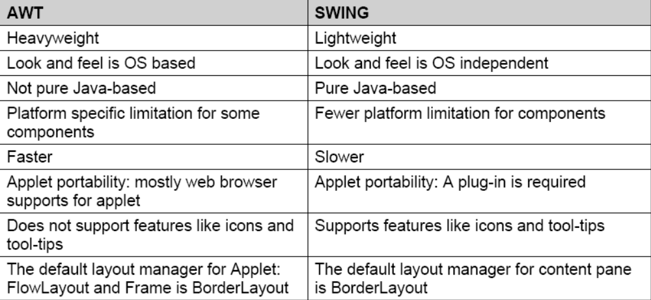
Differences between AWT & Swing

Slide 8
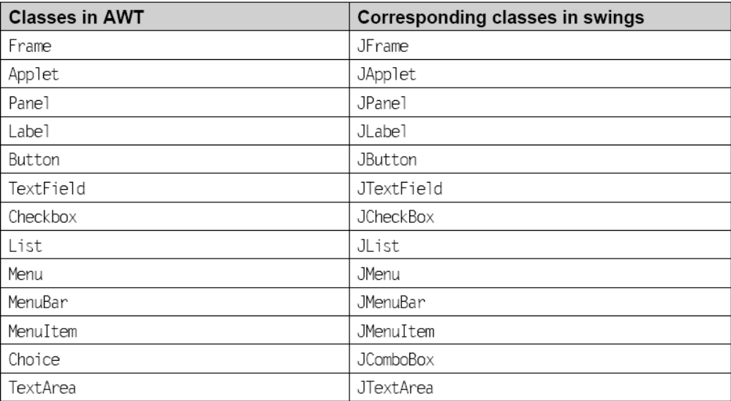
Few Classes in Swings

Slide 9
JFrame
Swing provides a top-level container to which components are added, e.g. JFrame, JApplet, etc.
JFrame is a subclass of java.awt. Frame so it inherits all the features of on HWT Frame.
Whenever you create a top-level container, an intermediate container of the top-level container named Root Pane (JRootPane) is automatically created.
This root pane has four sub-level containers (layers)
  Layered pane (JLayeredPane)
  Content pane ()
  Menu bar (optional) (JMenuBar)
  Glass pane (JGlass)

Slide 10
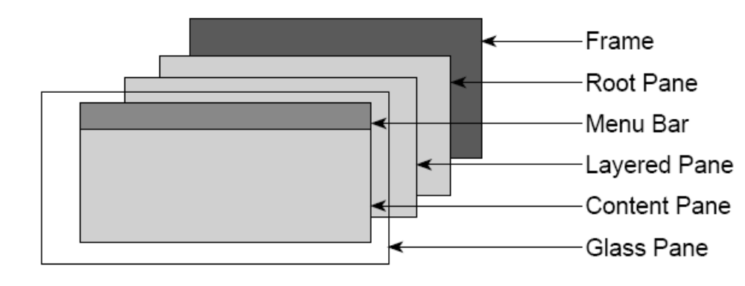
Panes in JFrame

Slide 11
JFrame (contd.)
All components are added to a content pane
There are two ways of getting a content pane:
  Every container has a content pane. The content pane is obtained using the method getContentPane( ) and it returns a Container object (Recommended). But now, You can directly use add() method
  Build your own content pane. For example,
    class Demo extends JFrame{
    …….
    JPanel panel = new JPanel( );
    panel.add( ….);
    panel.add( ….);
    ………
    panel.setOpaque(true);
    setContentPane(panel); // set JPanel as the content pane for the JFrame
    ….}

Slide 12
Example
import javax.swing.*;
public class DemoSwing extends JFrame {
void demoSwing () {
setTitle(“First Swing Program”);
setSize(300,200);
setDefaultCloseOperation(EXIT_ON_CLOSE);
JLabel label = new JLabel(“My first Swing program”);
add(label);
// pack();
setVisible(true); }
public static void main(String[] args) {
DemoSwing demo =new DemoSwing();
demo.demoSwing();} }

Slide 13
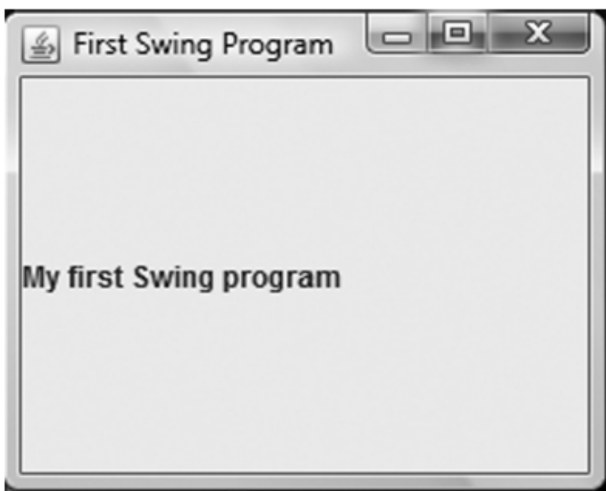
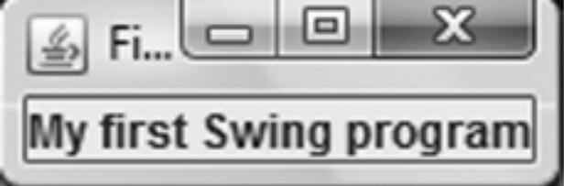
The Output
If pack line is uncommented

Slide 14
JApplet
JApplet is used for creating applets using swings.
JApplet is a container class like JFrame, so it possesses all the panes.
Components are added to JApplet as they are added in JFrame.
JApplet extends Applet class, so it contains all the features of AWT applet.
A class needs to be a subclass of JApplet for creating applets in swings.
The life cycle of a JApplet is same as the life cycle of an Applet.
You can override any of the life cycle methods whichever is required by your swing applet.
In swings, painting is avoided in paint() method.

Slide 15
Example
import java.awt.*;
import javax.swing.*;
/*<applet code=”JAppletDemo.class” width=”300” height=”100”> </applet>*/
public class JAppletDemo extends JApplet {
public void init() {
setLayout(new FlowLayout());
add(new JButton(“Button 1”));
add(new JButton(“Button 2”));
add(new JButton(“Button 3”));
}}

Slide 16
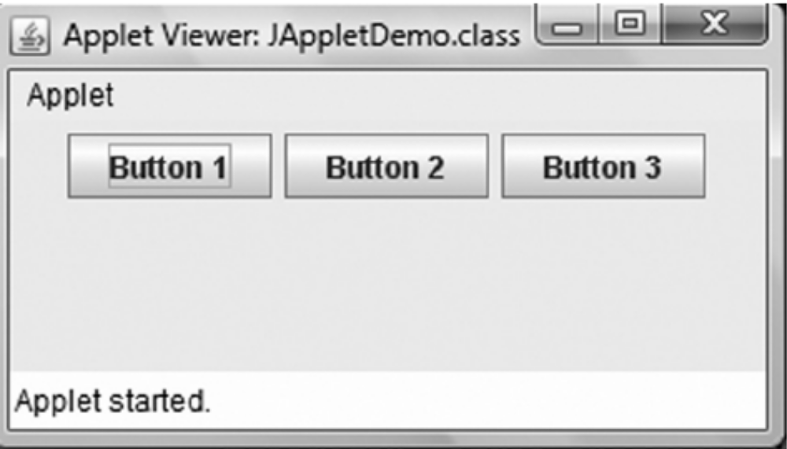
The Output

Slide 17
JPanel
JPanel is a lightweight container used for holding components like JButton, JLabel, JList, JToggleButton etc.
If you want to put a component to JPanel, then simply add it using add(Component c) method, then add the JPanel to its top-level Container like JFrame.
However, JPanel can also act as a replacement for Canvas class, as there is no JCanvas class in the swing package.
If JPanel is used in place of Canvas, you need to follow two additional steps.
  Firstly, set the preferred size via the method setPreferredSize
  Secondly, you should use paintComponent method for drawing, not paint. In addition to that, you should first clear the screen by calling super.paintComponent.

Slide 18
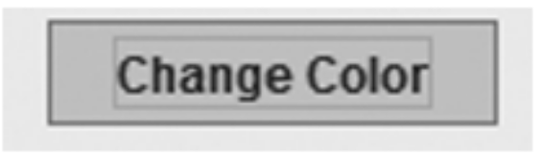

Components in Swings
Components present in AWT are all present in swings for e.g.
  checkbox (JCheckBox),
  Radio button (JRadioButton & ButtonGroup),
  Button (JButton),
  Label (JLabel),
  TextField (JTextField) etc.
  Toggle Button (which when clicked upon remains selected and state of the toggle button becomes deselected on clicking again)

Slide 19
Example
import java.awt.*; import java.awt.event.*;
import javax.swing.*;
public class ComponentDemo extends JFrame implements ItemListener{
JRadioButton m,f; JCheckBox c1,c2; JToggleButton tb;
Container content; JLabel lbl;
void componentDemo() {
setTitle (“Demo for Checkbox RadioButton & ToggleButton”);
content = getContentPane();
setSize(300,150);
setDefaultCloseOperation(EXIT_ON_CLOSE);
setLayout(new FlowLayout());
c1=new JCheckBox(“Music”); c2=new JCheckBox(“Dancing”);
c1.addItemListener(this); c2.addItemListener(this); add(c1); add(c2);m=new JRadioButton(“Male”);
f=new JRadioButton(“Female”);

Slide 20
Example (contd.)
ButtonGroup bg=new ButtonGroup();
bg.add(m); bg.add(f);
m.addItemListener(this);
f.addItemListener(this);
add(m); add(f);
tb=new JToggleButton(“Change Color”);
lbl=new JLabel(); add(lbl); tb.addItemListener(this);
add(tb); setVisible(true);}
public void itemStateChanged(ItemEvent ae){
if (ae.getItem()==tb && ae.getStateChange()==ItemEvent.SELECTED)
content.setBackground(Color.blue);
if(ae.getItem()==tb && ae.getStateChange()==ItemEvent.DESELECTED)
content.setBackground(Color.red);

Slide 21
Example (contd.)
if (ae.getItem()==c1 && ae.getStateChange()==ItemEvent.SELECTED)
lbl.setText(“Music”);
if (ae.getItem()==c2 && ae.getStateChange()==ItemEvent.SELECTED)
lbl.setText(“Dancing”);
if (ae.getItem()==m && ae.getStateChange()==ItemEvent.SELECTED)
lbl.setText(“Male”);
if (ae.getItem()==f && ae.getStateChange()==ItemEvent.SELECTED)
lbl.setText(“Female”);}
public static void main(String[] args) {
ComponentDemo demo=new ComponentDemo();
demo.componentDemo();
}}

Slide 22
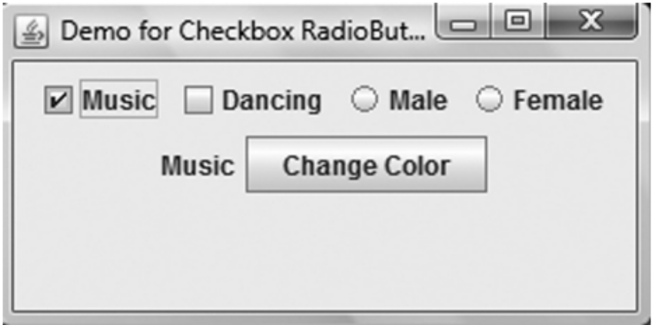
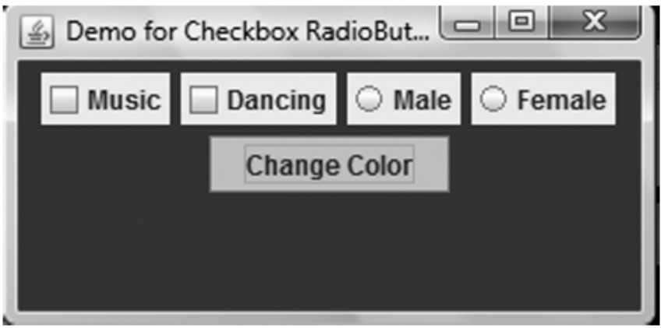
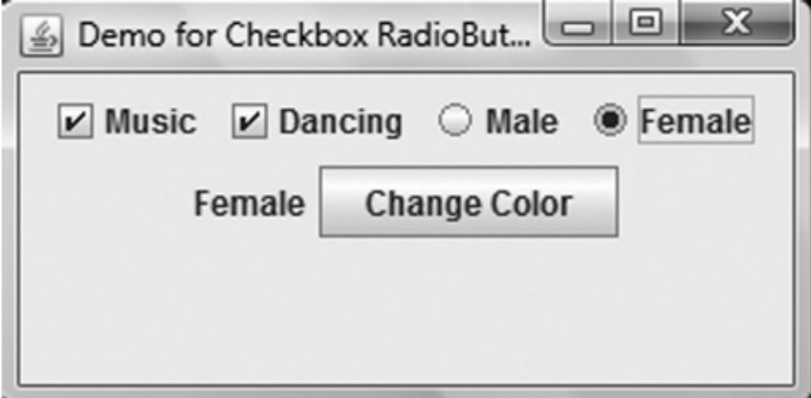
The Output

Slide 23
SpringLayout
SpringLayout is a very flexible layout
it does not place components on its own but according to the constraints specified by the putConstraint method.
The constraints specify
  distance between two edges of component or
  distance between the edges of a component and its container.
  The edges can be in any direction: north, south, east, or west.

Slide 24
SpringLayout
import java.awt.*; import javax.swing.*;
public class SpringDemo extends JFrame {
void springDemo() {
setDefaultCloseOperation(EXIT_ON_CLOSE);
setTitle(“Spring Layout”);
Container contentPane =getContentPane();
SpringLayout layout = new SpringLayout();
contentPane.setLayout(layout);
setSize(250,100);
JLabel label = new JLabel(“Name: “);
JTextField textField = new JTextField(“”, 15);
add(label); add(textField);
JButton b1= new JButton(“Submit”);
add(b1);

Slide 25
Example (contd.)
layout.putConstraint(SpringLayout.WEST, label, 5, SpringLayout.WEST, contentPane);
layout.putConstraint(SpringLayout.NORTH, label, 5, SpringLayout.NORTH,contentPane);
layout.putConstraint(SpringLayout.WEST, textField , 5 ,SpringLayout.EAST, label);
layout.putConstraint(SpringLayout.NORTH, textField ,5 ,SpringLayout.NORTH, contentPane);
layout.putConstraint(SpringLayout.HORIZONTAL_CENTER,b1,0,SpringLayout.HORIZONTAL_CENTER,contentPane);
layout.putConstraint(SpringLayout.SOUTH, b1, -5, SpringLayout.SOUTH,contentPane);
setVisible(true);}
public static void main(String[] args) {
SpringDemo demo=new SpringDemo();
demo.springDemo();}}

Slide 26
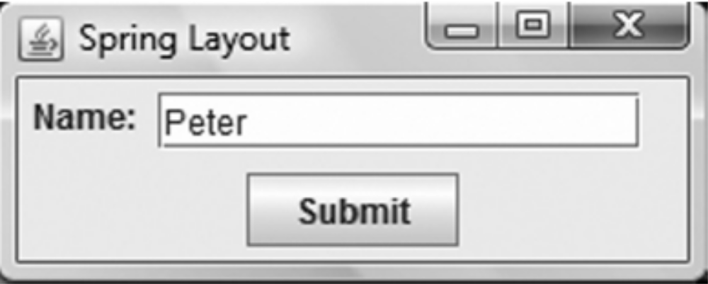
The Output

Slide 27
BoxLayout
places all the components in a single row or column.
we can put more than one panel in horizontal and vertical directions, similar to GridBagLayout.
It is designed with an axis parameter that specifies the type of layout. This can be done in four ways:
  X_AXIS - Components are placed horizontally from left to right.
  Y_AXIS - Components are placed vertically from top to bottom.
  LINE_AXIS - Components are placed in a line, based on the container’s ComponentOrientation property.
  PAGE_AXIS - Components are placed the way text lines are written on a page, based on the ComponentOrientation property of container.

Slide 28
Example
import java.awt.*; import javax.swing.*;
public class BoxDemo extends JFrame {
void boxDemo(){
setTitle (“BoxLayout”);
Container content = getContentPane();
setSize(200,150);
setDefaultCloseOperation(EXIT_ON_CLOSE);
BoxLayout b=new BoxLayout(content,BoxLayout.X_AXIS);
setLayout(b);
add(new JButton(“Button 1”));
add(new JButton(“Button 2”));
add(new JButton(“Button 3”));
setVisible(true);}
public static void main(String[] args) {
BoxDemo demo=new BoxDemo();
demo.boxDemo(); }}

Slide 29
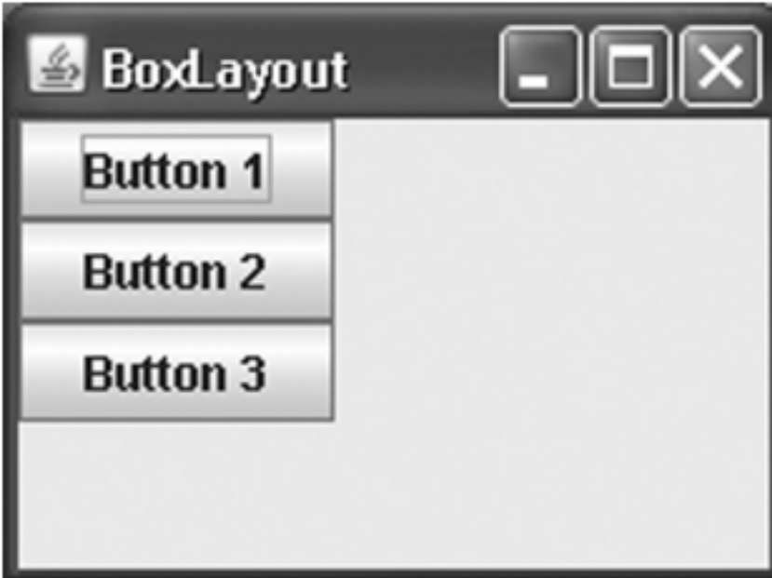
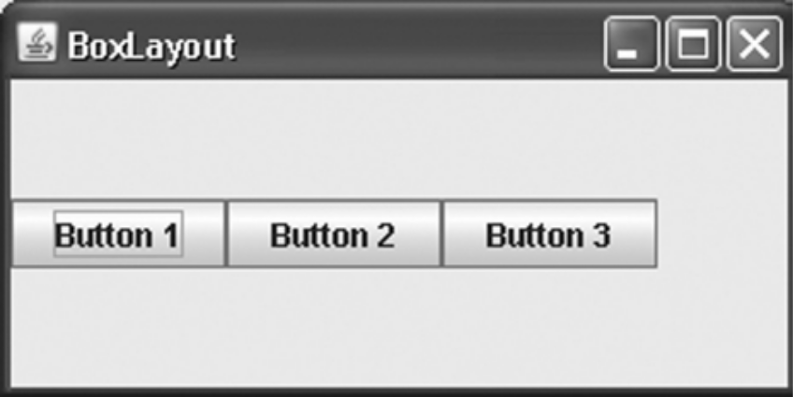
The Output

Slide 30
JList & JScrollPane
displays a group of items to the user and allows him/her to select one or more items from the list.
A class DefaultListModel (inherits ListModel interface) is normally used for maintaining a list.
  This class actually provides methods to add, remove all elements or a specific element, find the index of an element and so on.
  The setModel(ListModel l) method sets a model for the list.
The selection changes on a JList (results in ListSelectionEvent) are managed by another interface ListSelectionModel and traced by ListSelectionListener (part of javax. swing.event sub-package).

Slide 31
Example
import java.awt.*;
import javax.swing.*;
import javax.swing.event.*;
public class JListDemo extends JFrame implements ListSelectionListener{
JList list;JLabel l;
DefaultListModel model;
public JListDemo() {
setTitle(“JList Demo”);
setDefaultCloseOperation(EXIT_ON_CLOSE);
l=new JLabel();
setSize(260, 200);
model = new DefaultListModel();

Slide 32
Example (contd.)
list = new JList(model);
JScrollPane pane = new JScrollPane(list);
for (int i = 0; i < 10; i++)
model.addElement(“List Item: “ + i);
list.addListSelectionListener(this);
add(pane, BorderLayout.NORTH);
add(l,BorderLayout.SOUTH);
setVisible(true); }
public void valueChanged(ListSelectionEvent e){
l.setText((String)list.getSelectedValue());}
public static void main(String s[]) {
new JListDemo();}}

Slide 33
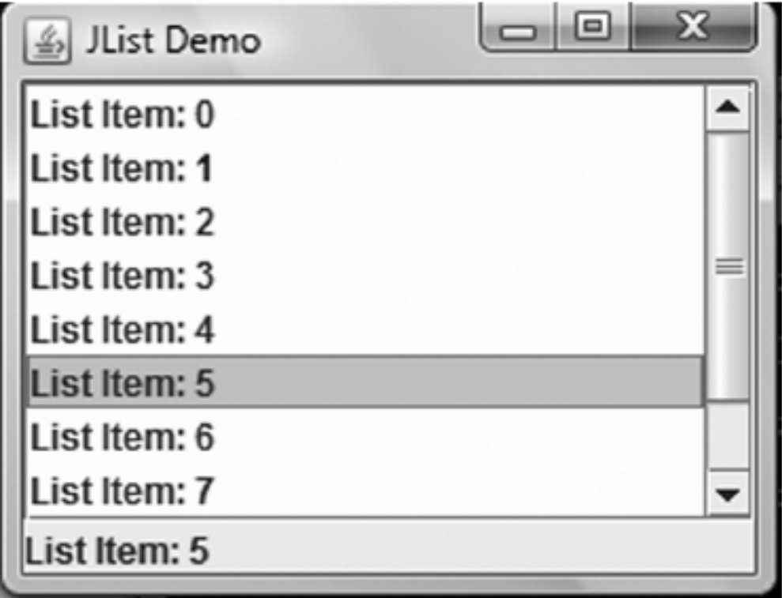
The Output

Slide 34
SplitPane
The split pane is a container that graphically separates the components,
  either horizontally (JSplitPane.HORIZONTAL_SPLIT) or
  vertically (JSplitPane.VERTICAL_SPLIT).
It can display two components at a time and the display areas can be adjusted by the user.

Slide 35
Example
import javax.swing.*;
public class DemoSplitPane extends JFrame {
public void demoSplitPane() {
setTitle(“Split Pane”); setSize(250, 250);
setDefaultCloseOperation(JFrame.EXIT_ON_CLOSE);
JPanel jpane1 = new JPanel();
JPanel jpane2 = new JPanel();
JLabel jlb1 = new JLabel(“First Area 1”);
JLabel jlb2 = new JLabel(“Second Area 2”);
jpane1.add(jlb1); jpane2.add(jlb2);
JSplitPane splitPane = new JSplitPane (JSplitPane.VERTICAL_SPLIT,true, jpane1, jpane2);
splitPane.setOneTouchExpandable(true);
add(splitPane); setVisible(true);}
public static void main(String[] args) {
DemoSplitPane demo=new DemoSplitPane();
demo.demoSplitPane();}}

Slide 36
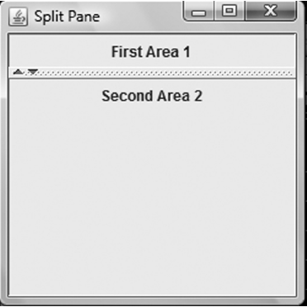
The Output

Slide 37
JTabbedPane
import java.awt.*;
import javax.swing.*;
import javax.swing.event.*;
public class JTabbedPaneDemo extends JFrame{
JLabel lbl,txt;
JToggleButton jb;
JTabbedPane jt;
JTabbedPaneDemo() {
setTitle(“JTabbedPane”);
setDefaultCloseOperation(EXIT_ON_CLOSE);
lbl = new JLabel(“Label in Tab1”);
JPanel panel1 = new JPanel();
panel1.add(lbl);
JPanel panel2 = new JPanel();
jb=new JToggleButton(“Change Color”);

Slide 38
Example (contd.)
panel2.add(jb);
jt=new JTabbedPane();
jt.addTab(“Tab 1”, panel1);
jt.addTab(“Tab 2”, panel2);
jt.setToolTipTextAt(0,”Tab 1”);
jt.setToolTipTextAt(1,”Tab 2”);
add(jt,BorderLayout.NORTH);
txt=new JLabel();
add(txt,BorderLayout.CENTER);
setSize(300,200); setVisible(true);
jt.addChangeListener(new ChangeListener() {
public void stateChanged(ChangeEvent e) {
txt.setText(“Tab selected: “ + jt.getSelected Index());}});}
public static void main(String args[]) {
new JTabbedPaneDemo();} }

Slide 39
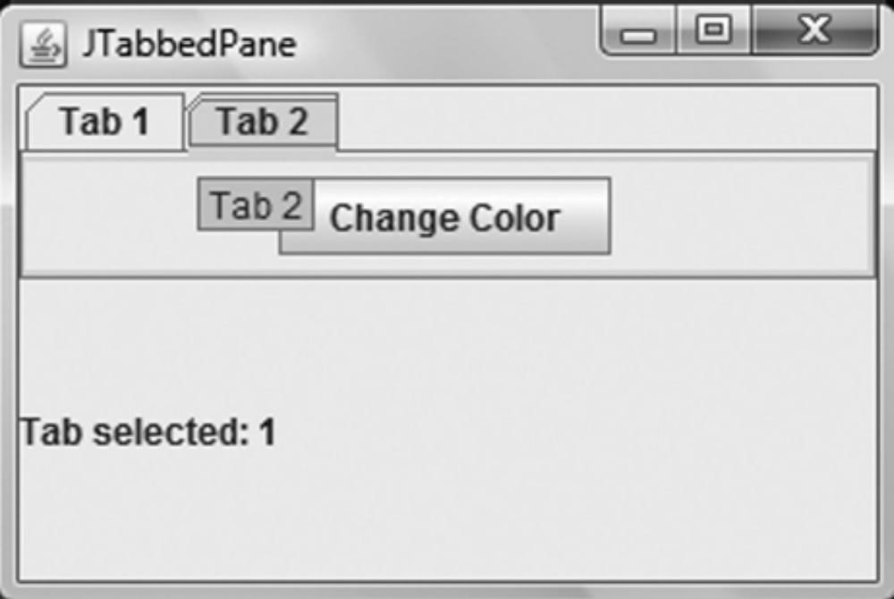
The Output

Slide 40
Dialog Boxes
There are four types of dialog boxes available in java swings:
  Confirm Dialog: It seeks the user’s response, e.g. YES/NO/CANCEL
  Message Dialog: Informs the user about something
  Input Dialog: Asks the user to enter a value.
  Option Dialog: to choose a value from a given set of values.
These dialog boxes can be created with the help of a class: JOptionPane.
Confirm dialog is created using the
  public static int showConfirmDialog(Component parent, Object msg, String title, int optiontype) throws HeadlessException
  Where parent is the frame in which the dialog will be displayed.
  msg is the message that will be displayed in the dialog.
  title sets the title of the dialog.
  optiontype may be one of the following:
    JOptionPane.DEFAULT_OPTION
    JOptionPane.YES_NO_OPTION
    JOptionPane.YES_NO_CANCEL_OPTION
    JOptionPane.OK_CANCEL_OPTION

Slide 41
Message Dialog Box
The message dialog displays a message to the user.
  public static void showMessageDialog(Component parent, Object msg) throws HeadlessException
    or
  public static void showMessageDialog(Component parent, Object msg, String title, int messagetype) throws HeadlessException
  where messagetype may be one of the following:
    JOptionPane.ERROR_MESSAGE
    JOptionPane.INFORMATION_MESSAGE
    JOptionPane.WARNING_MESSAGE
    JOptionPane.QUESTION_MESSAGE
    JOptionPane.PLAIN_MESSAGE

Slide 42
Input and Option Dialog Box
The input dialog is used to get input from the user .
It seeks input from the user and returns it as a string.
  public static String showInputDialog(Component parent, Object msg, String title, int messagetype) throws HeadlessException
  or
  public static String showInputDialog(Component parent, Object msg) throws HeadlessException
The option dialog displays a list of options to the user and prompts him to choose one.
  public static int showOptionDialog(Component parent, Object msg, String title, int optiontype, int messagetype, Icon i, Object[] option, Object initialValue) throws HeadlessException

Slide 43
Look And Feel
Java provides pluggable look and feel.
You can change the look and feel of the GUI displayed to the user.
The look and feel is provided by the following packages and their sub-packages.
  javax.swing.plaf
  javax.swing.plaf.basic
  javax.swing.plaf.metal
  javax.swing.plaf.multi
  javax.swing.plaf.synth
  javax.swing.plaf.nimbus (introduced in Java 6 update 10)
The System Look and Feel packages are shipped along with Java SDK
  com.sun.java.swing.plaf.gtk.GTKLookAndFeel (for Solaris/Linux)
  com.sun.java.swing.plaf.motif.MotifLookAndFeel (any platform)
  com.sun.java.swing.plaf.windows.WindowsLookAndFeel (only Windows)

Slide 44
Look And Feel
Java provides the following look and feel:
  A cross-platform look and feel (aka Metal) is the default look and feel in Java, looks uniform on all platforms (javax.swing.plaf.metal.MetalLookAndFeel).
  A system-defined (native) look and feel shows the GUI according to the look and feel of the native system.
  Synth – Using this, you can create your own look and feel (javax.swing.plaf.synth. SynthLookAndFeel).
  Multiplexing – Delegates to different look and feel at same time.
  (javax.swing.plaf.multi.MultiLookAndFeel).
  Nimbus A new cross-platform look and feel introduced Java 6 update 10 (javax.swing.plaf.nimbus.NimbusLookAndFeel)
  GTK+ This look and feel runs on Solaris and Linux O.S which have GTK+ 2.2 or later
  IBM Unix, HP Unix, and Macintosh provide their own Look and Feel.

Slide 45
Look And Feel
javax.swing.UIManager class provides methods to set and get the look and feel
  getLookAndFeel( ) and
  setLookAndFeel()
Their signatures are as follows:
  static LookAndFeel getLookAndFeel()
  static void setLookAndFeel(LookAndFeel l)
  static void setLookAndFeel(String className)

Slide 46
Look And Feel
LookAndFeel class is the parent of all the look and feel classes in Java. It has two subclasses,
  BasicLookAndFeel and
  MultiLookAndFeel.
The BasicLookAndFeel is inherited by MetalLookAndFeel and SynthLookAndFeel.
The metal look and feel has themes associated with it.
The default theme is OceanTheme.
Prior to JDK5 the default theme was DefaultMetalTheme (aka Steel). These themes can be get/set using MetalLookAndFeel class methods:
  public static void setCurrentTheme(MetalTheme m)
  public static MetalTheme getCurrentTheme()

Slide 47
JTree
used to display hierarchical data.
The tree obtains its data by querying its data model.
JTree displays the data vertically.
Each row contains exactly one node.
There are three types of nodes in a JTree:
  root node,
  branch node, and
  leaf node.
All nodes will have a common root node at the top.
A node can either have children (branch node) or cannot have children (leaf node).

Slide 48
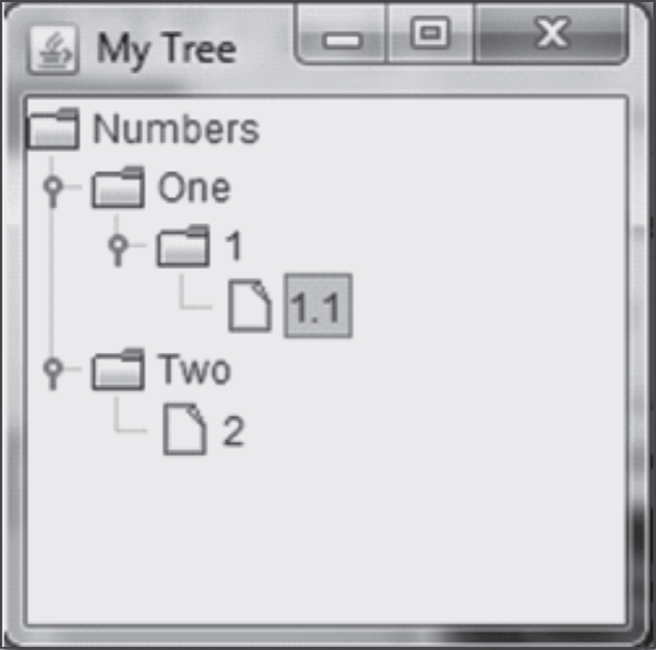
A Sample JTree
Numbers is a root node.
1.1 and 2 are leaf nodes
rest are branch nodes
structure of a Tree is created using DefaultTreeModel class.
All nodes within this model are created using DefaultMutableTreNode class.

Slide 49
How to add Nodes to a JTree
JTree jt;
DefaultTreeModel dtm;
DefaultMutableTreeNode dtm1;
DefaultMutableTreeNode two=new DefaultMutableTreeNode("Two");
DefaultMutableTreeNode twoInNumber=new DefaultMutableTreeNode("2");
two.add(twoInNumber);
dtm1.add(two);
dtm = new DefaultTreeModel (dtm1,true);
jt = new JTree(dtm1);

Slide 50
JTree Listener
jt.addTreeExpansionListener(new TreeExpansionListener()
{
public void treeCollapsed(TreeExpansionEvent te){
System.out.println("Collapsed");
}
public void treeExpanded( TreeExpansionEvent te)
{
System.out.println(jt.getLeadSelectionPath());
System.out.println(
jt.getLastSelectedPathComponent());
}
});

Slide 51
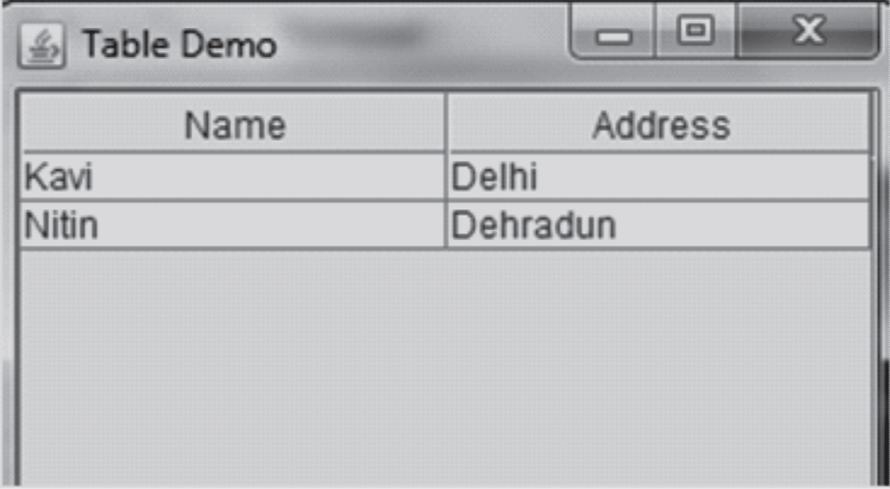
JTable
The JTable class lets you display tables of data

Slide 52
JTable Example
JTable jt;
JScrollPane jsp;
Object row[][]={{"Kavi","Delhi"},{"Nitin","Dehradun"}};
Object col[]={"Name","Address"};
jt = new JTable(row,col);
To enable cell selection
  jt.setCellSelectionEnabled(true);

Slide 53
JTable Event Hander
jt.addMouseListener(new MouseAdapter(){
public void mouseClicked(MouseEvent me){
String string = (String)jt.getValueAt (jt.getSelectedRow() ,jt.getSelectedColumn());
// Display the selected item
System.out.println( "Value selected = " + string );
}});
jsp=new JScrollPane(jt);
add(jsp);

Slide 54
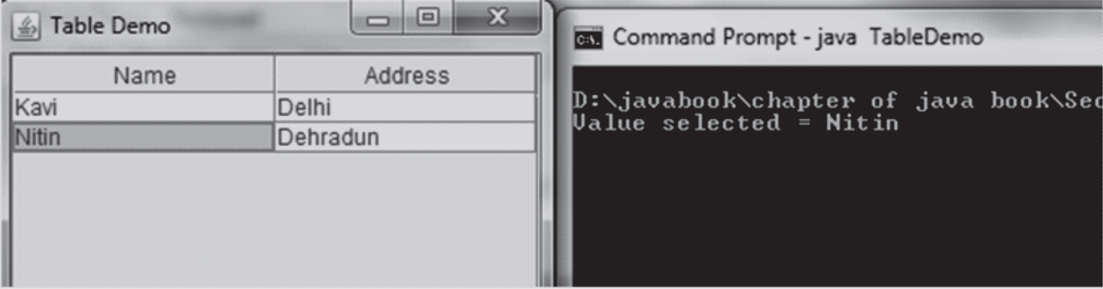
The Output

Slide 55
JFileChooser
provides a file open dialog where a user can choose to open or save files.
navigates the file system to choose a file or directory.
showOpenDialog method is used to show the Open file dialog and
showSaveDialog method is used to show the Save file dialog.

Slide 56
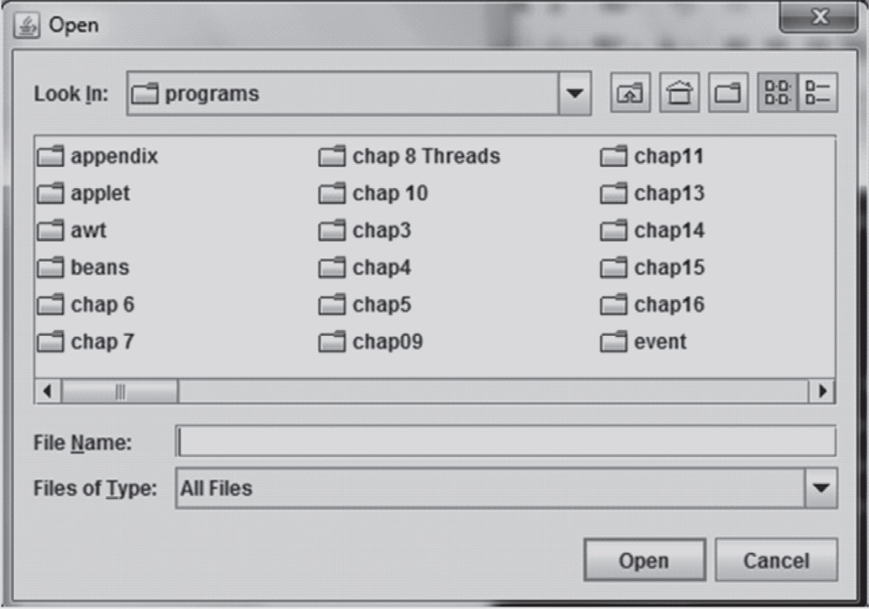
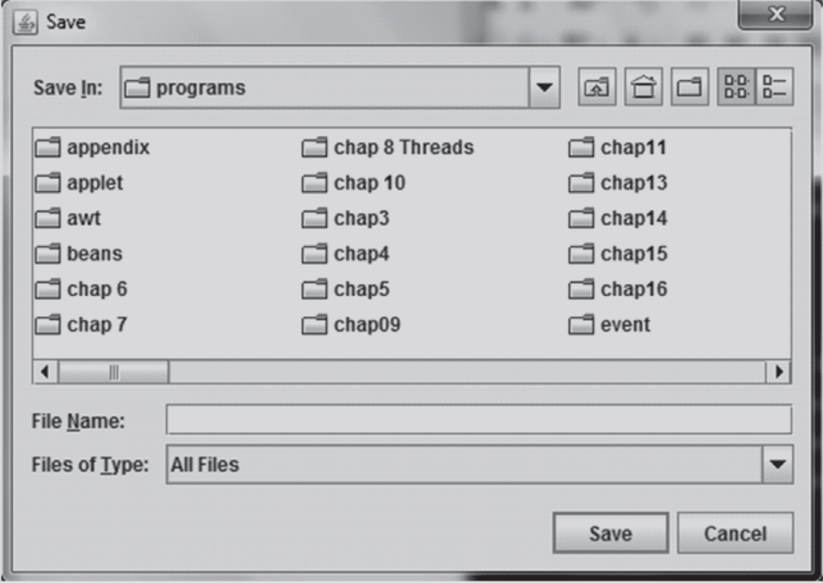
Open and Save file chooser dialogs

Slide 57
JColorChooser
a Tabbed control which can be used to manipulate and select a color
JColorChooser can be created by using a showDialog static method.
This method displays the dialog on top of the container where you can choose a color of your choice.
  JColorChooser.showDialog(parent component, title, default color)

Slide 58
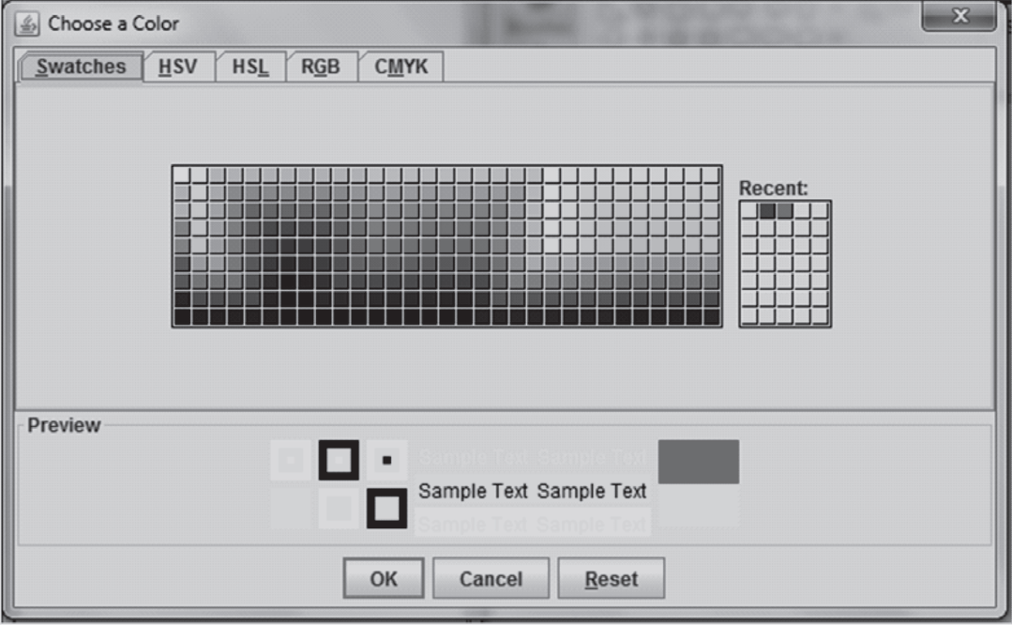
JColorChooser

Slide 59
Inner Frames
Inner frame is a frame within a frame.
Inner frames are created using javax.swing.JInternalFrame class.
It is a lightweight object that provides many features of a JFrame, like
  dragging,
  closing,
  becoming an icon,
  resizing,
  title display, and
  support for a menu bar.

Slide 60
Inner Frames
JDesktopPane dp = new JDesktopPane();
JInternalFrame jif= new JInternalFrame("Internal Frame "+count++,false,true,true,true);
The argument are as follows:
  title,
  resizable,
  closable,
  maximizable,
  iconifiable

Slide 61
Inner Frame Event handler
jif.addInternalFrameListener(new InternalFrameAdapter() {
public void internalFrameActivated( InternalFrameEvent i)
{ System.out.println(" Internal Frame Activated"); }
public void internalFrameOpened(InternalFrameEvent i)
{ System.out.println("New Internal Frame Opened"); }
public void internalFrameIconified(InternalFrameEvent i)
{ System.out.println(" Internal Frame Minimized "); }
public void internalFrameDeiconified(InternalFrameEvent i)
{ System.out.println(" Internal Frame Maximized"); }
public void internalFrameDeactivated(InternalFrameEvent i)
{ System.out.println(" Internal Frame Deactivated"); }

Slide 62
Inner Frame Event handler
public void internalFrameClosing(InternalFrameEvent i)
{
System.out.println(" Internal Frame Closing");
}
public void internalFrameClosed(InternalFrameEvent i)
{
System.out.println(" Internal Frame Closed");
}
});

Slide 63
Summary
Swing components are written in Java, so they are portable and the GUI has a pluggable look and feel.
Many new components have been added in swings
  JSplitPane splits the display area into parts.
  JTabbedPane groups together a number of components and displays them as a unit.
  JScrollPane has all the functionality of a scrollbar as well as view pane.
  Dialog boxes (provided by other GUI software tools) are also provided by swing package namely confirm dialog, input dialog, option dialog, and message dialog.
New layouts have been added in swings like BoxLayout and SpringLayout.
The pluggable look and feel feature gives Java an upper edge over other languages.
The cross-platform look and feel gives Java GUI a standard look and feel which is uniform on all platforms.

